Slide 1
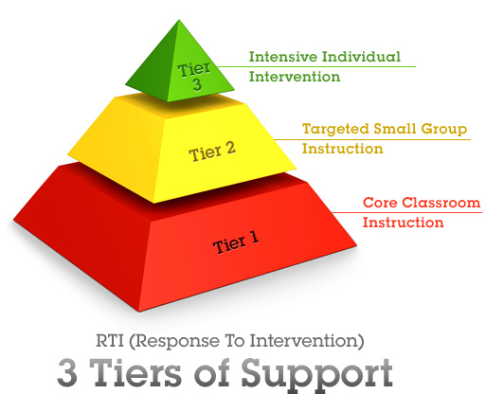

Slide 2
RTI
Response to Intervention (RTI) is a multi-tier approach to the early identification and support of students with learning and behavior needs.
Struggling learners are provided with interventions at increasing levels of intensity to accelerate their rate of learning.
These services may be provided by a variety of personnel, including general education teachers, special educators, and specialists.
Progress is closely monitored to assess both the learning rate and level of performance of individual students.
Educational decisions about the intensity and duration of interventions are based on individual student response to instruction.

Slide 3
For RTI to work there is…
High-quality, scientifically based classroom instruction.
*All students receive high-quality, research-based instruction in the general education classroom.
Ongoing student assessment.
*Universal screening and progress monitoring provide information about a student’s learning rate and level of achievement, both individually and in comparison with the peer group. These data are then used when determining which students need closer monitoring or intervention.
*Throughout the RTI process, student progress is monitored frequently to examine student achievement and gauge the effectiveness of the curriculum. Decisions made regarding students’ instructional needs are based on multiple data points taken in context over time.
Tiered instruction.
A multi-tier approach is used to efficiently differentiate instruction for all students. The model incorporates increasing intensities of instruction offering specific, research-based interventions matched to student needs.

Slide 4
Tier 1
Students receive high-quality, scientifically based instruction provided by qualified personnel to ensure that their difficulties are not due to inadequate instruction.
All students are screened on a periodic basis to establish an academic and behavioral baseline and to identify struggling learners who need additional support.
Students identified as being “at risk” through universal screenings and/or results on state- or districtwide tests receive supplemental instruction during the school day in the regular classroom. During that time, student progress is closely monitored.
At the end of this period, students showing significant progress are generally returned to the regular classroom program. Students not showing adequate progress are moved to Tier 2.

Slide 5
Tier 2
Students not making adequate progress in the regular classroom in Tier 1 are provided with increasingly intensive instruction matched to their needs on the basis of levels of performance and rates of progress.
Intensity varies across group size, frequency and duration of intervention, and level of training of the professionals providing instruction or intervention.
These services and interventions are provided in small-group settings in addition to instruction in the general curriculum. Students who continue to show too little progress at this level of intervention are then considered for more intensive interventions as part of Tier 3.

Slide 6
Tier 3
At this level, students receive individualized, intensive interventions that target the students’ skill deficits.
Students who do not achieve the desired level of progress in response to these targeted interventions are then referred for a comprehensive evaluation and considered for eligibility for special education services under the Individuals with Disabilities Education Improvement Act of 2004 (IDEA 2004).
The data collected during Tiers 1, 2, and 3 are included and used to make the eligibility decision. This is typically about 5% of your student population.

Slide 8
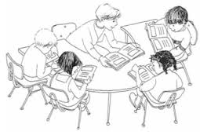
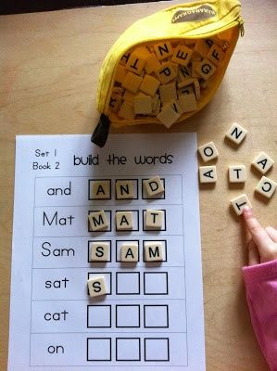

Slide 9
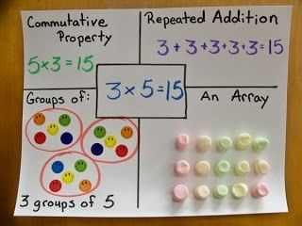
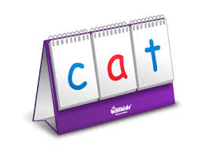

Slide 11
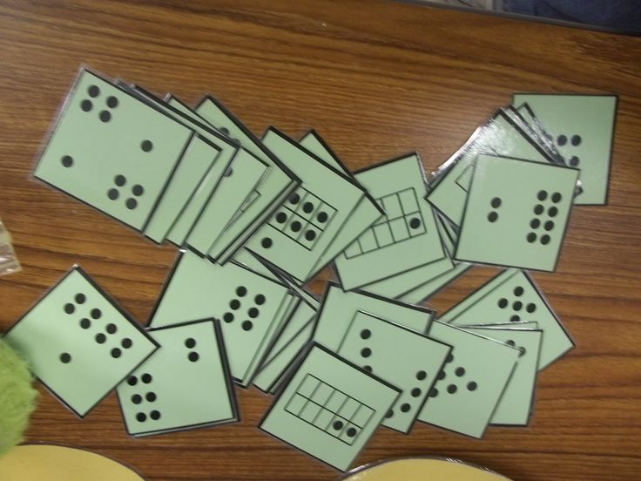

Slide 12
Study Skills
These skills are critical to success in school, and considered essential for acquiring good grades, and useful for learning throughout one's life.
These skills include:
Time Management
Organization
Test Preparation
Study Strategies
Listening Effectively
Taking Notes
*Taught to 5th and 6th grade

Slide 13
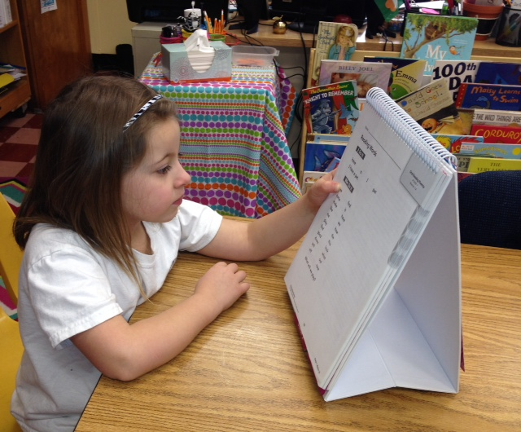

Slide 14
ACADEMIC
INTERVENTION

Slide 15
